Slide 1


The Healing Infirmary
Software Project- 1 [G1]
Instructed by Sir,ABHIJIT BHOWMIK

Slide 2
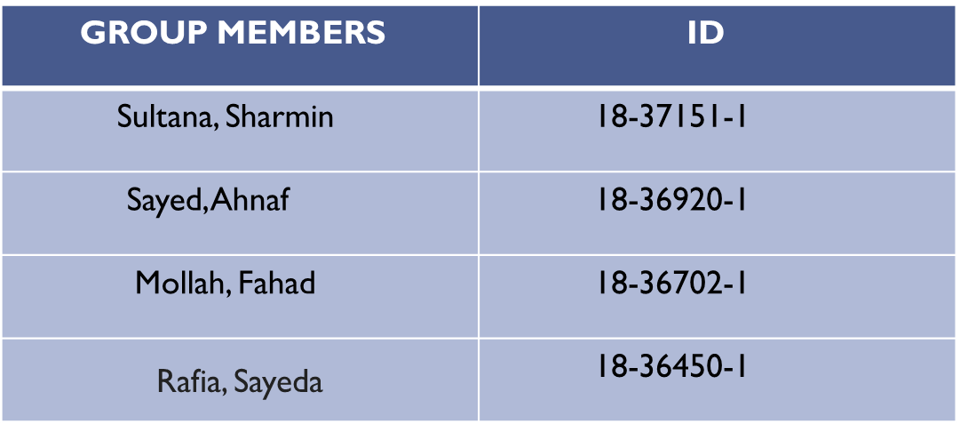
GROUP MEMBERS

Slide 3
Project Objective/Motivation
There will be many functionalities in “The Healing Infirmary” system that will fulfil any users expectancy.
Anyone can easily find what they need nearest to their location using this system.
People can easily get the necessary information about the test, availability of a doctor, cost of consultation and appointment, cost of hospitalization.

Slide 4
Benefits of Our System
Online booking appointment for patients without facing any hassle.
Online ambulance booking system for patients.
Online medicine ordering system for patients using doctor’s prescription.
Fast and safe booking.
Online payment system.
Time remainder notification system for next visit or appointment with doctor.
Appointment remainder notification system.
Efficient time management.
Offering any kind of discount.
Online interaction with the doctor on daily basis using the system.
Schedule and appointment history.
Fast & safe booking.
Checking bill information.
Messaging system.
From our hospital pharmacy store, Register or Non-Register Patient can order & purchase medicine cash on home delivery.
Online patient or client registration instead of traditional form full up.

Slide 5

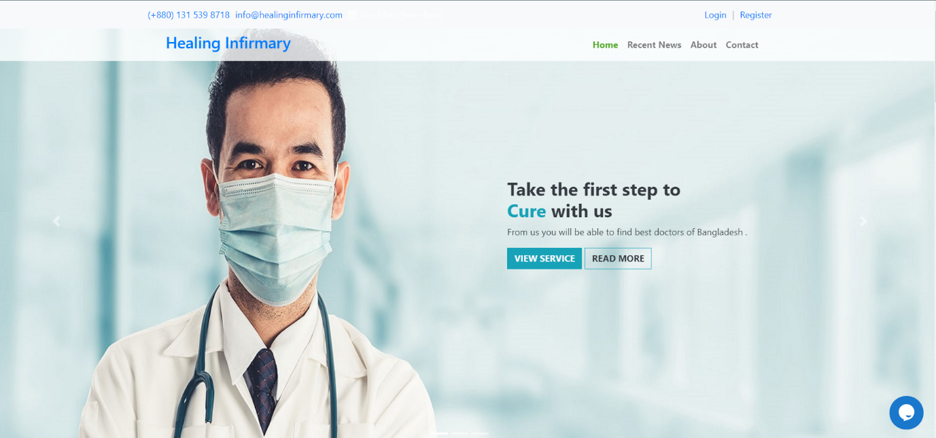

Slide 6
MISSION
VISION
We are committed to serve for human kind. At Healing, we do things passionately to help people live healthier and happier. We understand that our responsibilities are more towards our communities as they believe Healing is the place to rely on and trust. We believe it is our sacred responsibility to repay the debt to the soil which gave us birth. Our every activity is driven by this belief. Today Healing is the name of quality, care and trust. We have always been values driven company. We consider these values as the heart of company and soul of the business.
Excellence through innovation is the central concept of our vision. This vision helps us to find the driving way. In a competitive and fast-changing world, the business dynamics are constantly changing. Today only innovation can bring excellence and add value to products and services that can satisfy our customers.

Slide 7
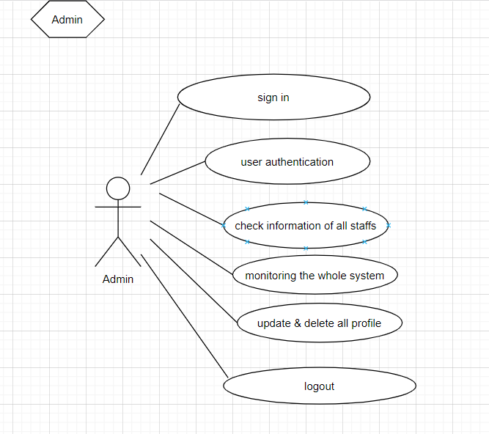
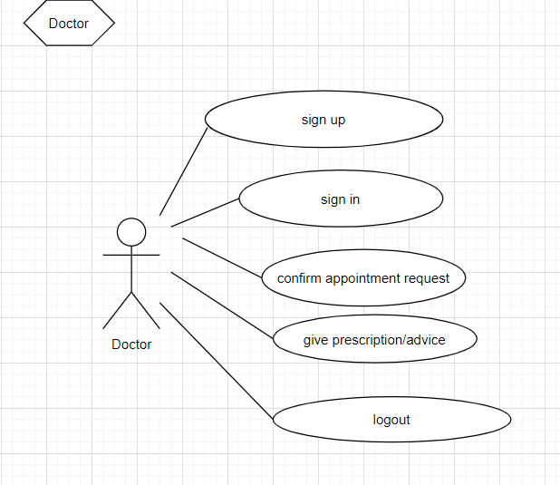
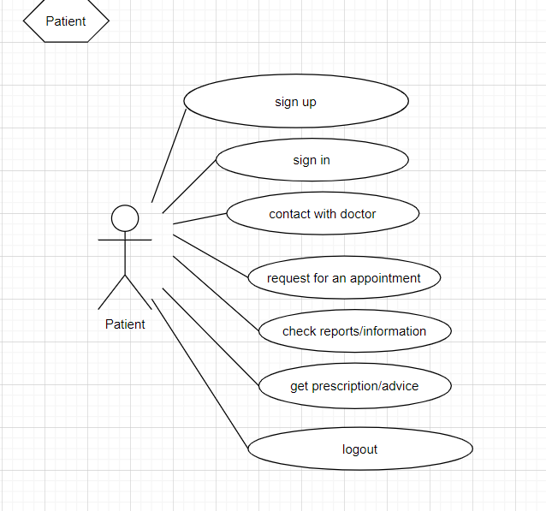
Project Details-User
Figure: Admin Use Case Diagram
Figure: Doctor Use Case Diagram
Figure: Patient Use Case Diagram

Slide 8
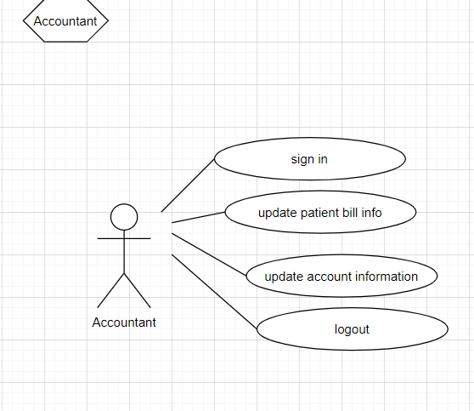
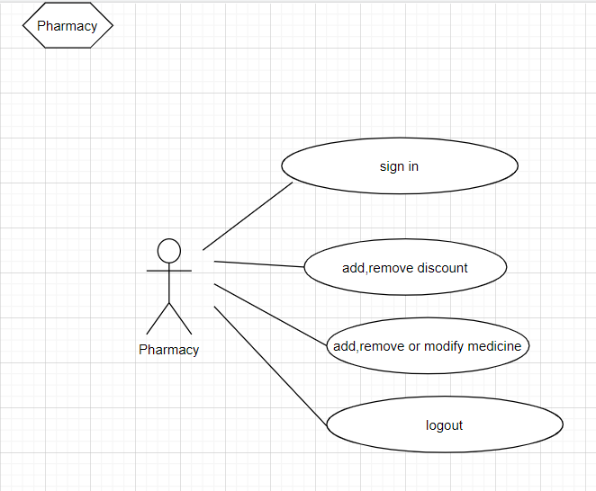
Project Details-User
Figure: Accountant Use Case Diagram
Figure: Pharmacy Use Case Diagram

Slide 9
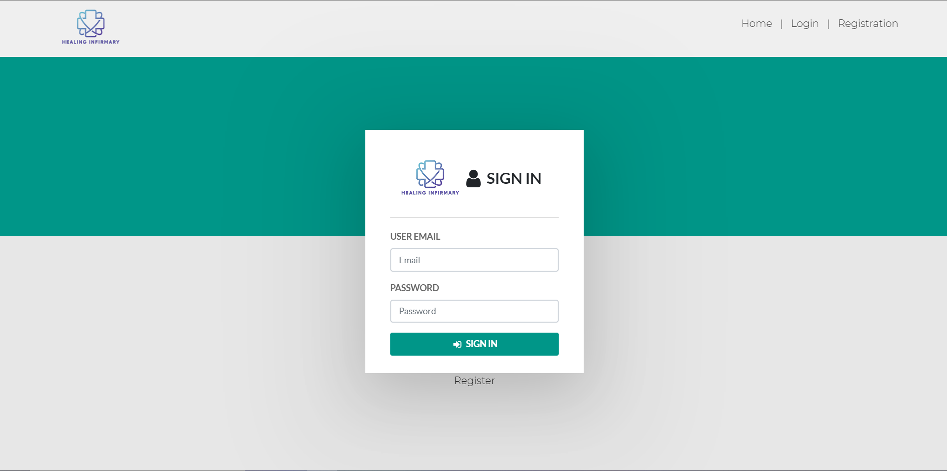
Project Details-Functionality
Log in/Log out:
If the user is old he/she can automatically log in using proper validation.
If the user is new he/she need to create an account by registering into the system.

Slide 10
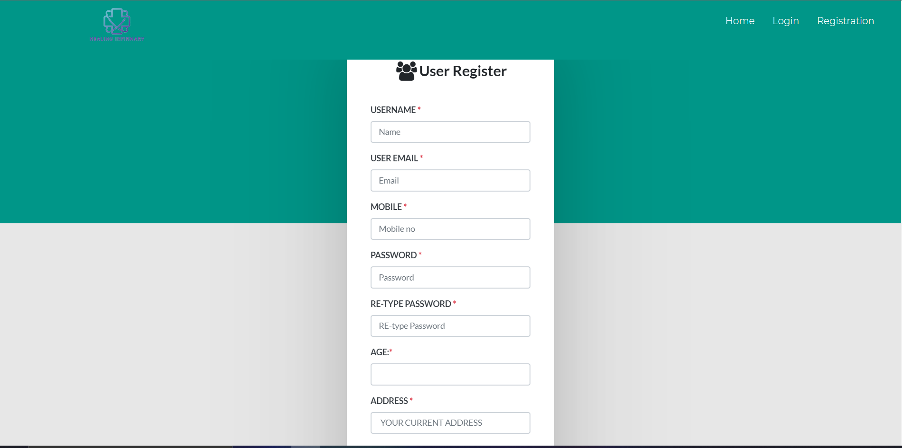
Project Details-Functionality
REGISTRATION :
For new user they need to
add all his information for
registration to log in.

Slide 11
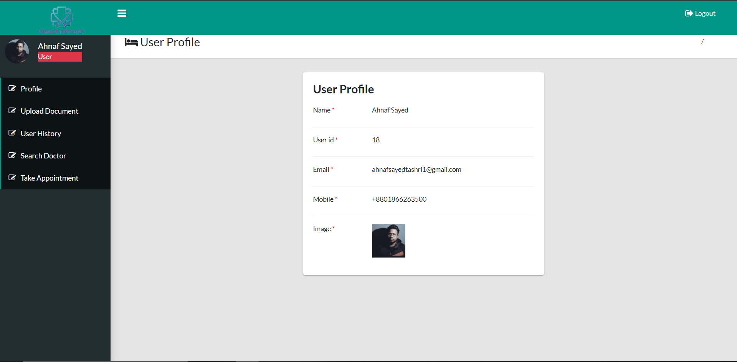
Project Details-Functionality
User Dashboard :
Users can use the system at ease and can choose their desired option from the user dashboard.

Slide 12
Project Details-Functionality
Hospital :
User/Patient can search for hospitals those close and nearest to them.

Slide 13
Project Details-Functionality
Pharmacy:
User or Non-User can order medicine and Doctor can prescribe medicine directly to the Pharmacy that he/she would order.
User or Non-User can order medicine that are nearest to their location and can take home delivery.

Slide 14
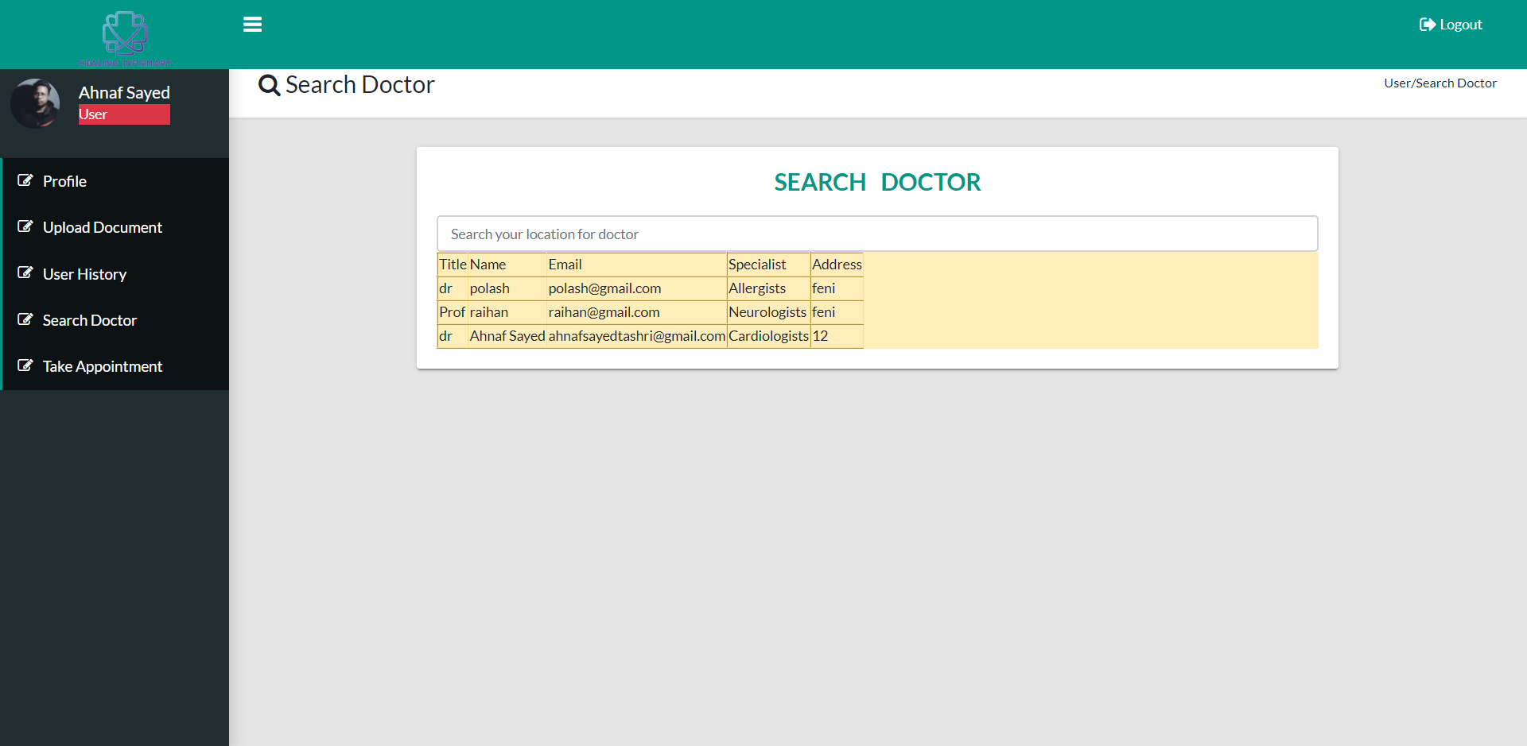
Project Details-Functionality
Searching a Doctor:
Users can easily search and identify doctor’s who are available.

Slide 15
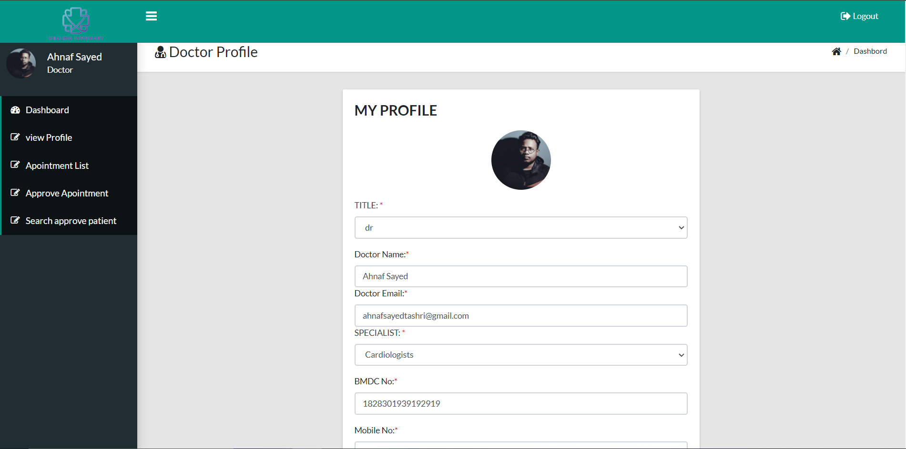
Project Details-Functionality
Doctor Dashboard:
Doctors can easily use the system and can choose their desired option from the doctor dashboard.

Slide 16
Project Details-Functionality
Payment:
Here User and Non user can make their payment if he/she take appointment from doctor or purchase some medicine from online.
They can also use mobile banking system for payment.

Slide 17

THANKS!
Do you have any questions?
info@healinginfirmary.com
(+880) 1729918870
healinginfirmary.com
Also You can find us at:
sharminsultana2548@gmail.com
ahnafsayedtashri@gmail.com
fahadmollah43@gmail.com
sayeda.rafia2000@gmail.com

